Slide 1
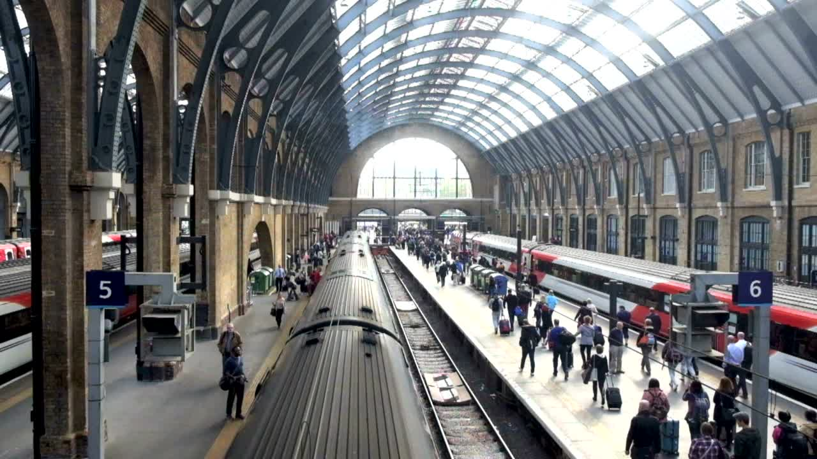



UK Train Rides
Power BI Final Project

Slide 2









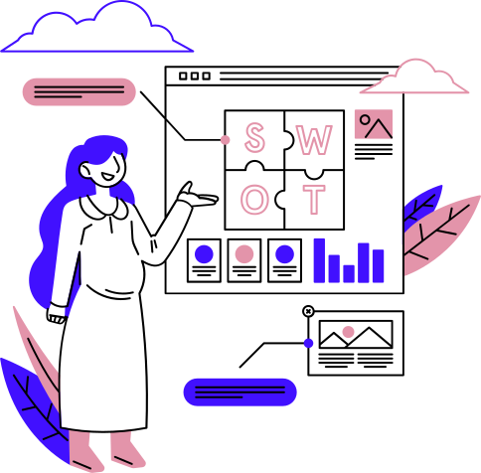


02
Our Team
Mohamed
Ashraf
Mariam
Abdalla
Shahd
Rafat
Nayera
Elnems
Wesal
Mohamed
Sohaila
Salama
View Profile
View Profile
View Profile
View Profile
View Profile
View Profile
01
02
03
04
05
06

Slide 3
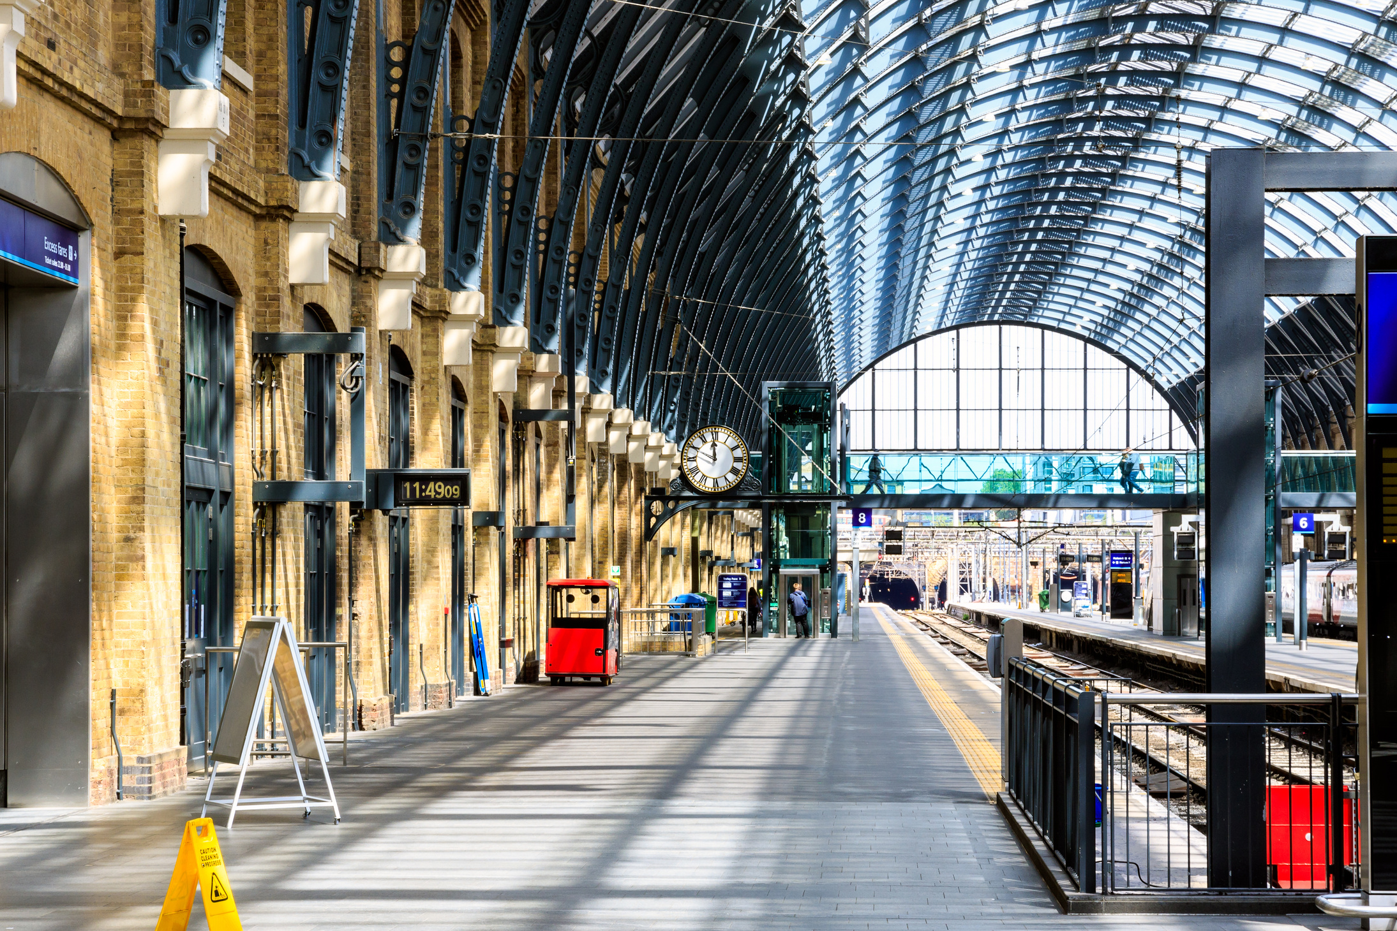

03
Uk Train Rides Dataset
About :
The UK Trains dataset contains information related to train operations and services within the United Kingdom. It provides structured data that can be used for analysis of train schedules, routes, and performance patterns.
Data Source and format :
The dataset was acquired from the Ministry of Communications and Information Technology, ensuring its authenticity and reliability. The data is stored in Excel format (.xlsx), making it easy to handle and analyze with common data analysis tools.
Learn More

Slide 4


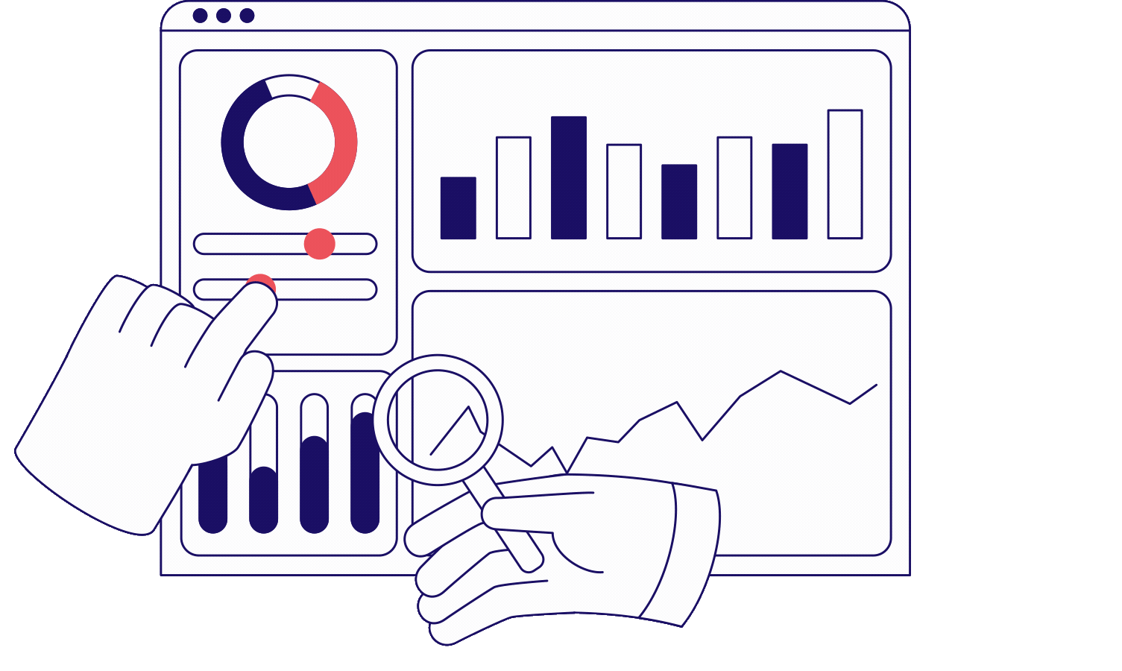





04
Project Overview
06
05
04
03
02
01
Dashboard
Report
Visual Sample
DAX
Data Modeling
Data Preprocessing

Slide 5







Data Preprocessing Steps
05
Data Formating
Data Cleaning
Feature Engineering
Converted Date of Purchase and Date of Journey → Date format
Converted Departure Time, Arrival Time, Actual Arrival Time → Time format
Converted Price → Accounting format
Replaced null values in Reason for Delay
Added new derived columns:
Journey_Day, Journey_Month
Purchase_Day, Purchase_Month
Journey_Duration (mins), Delay_Duration (mins)
Book_lead_time, Is_Cancelled

Slide 6

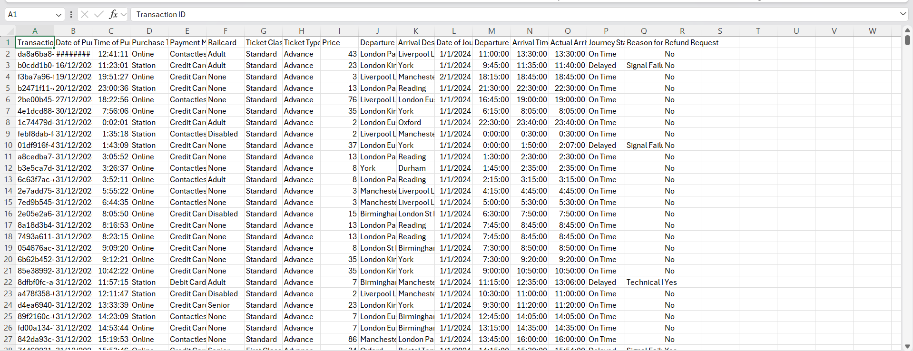
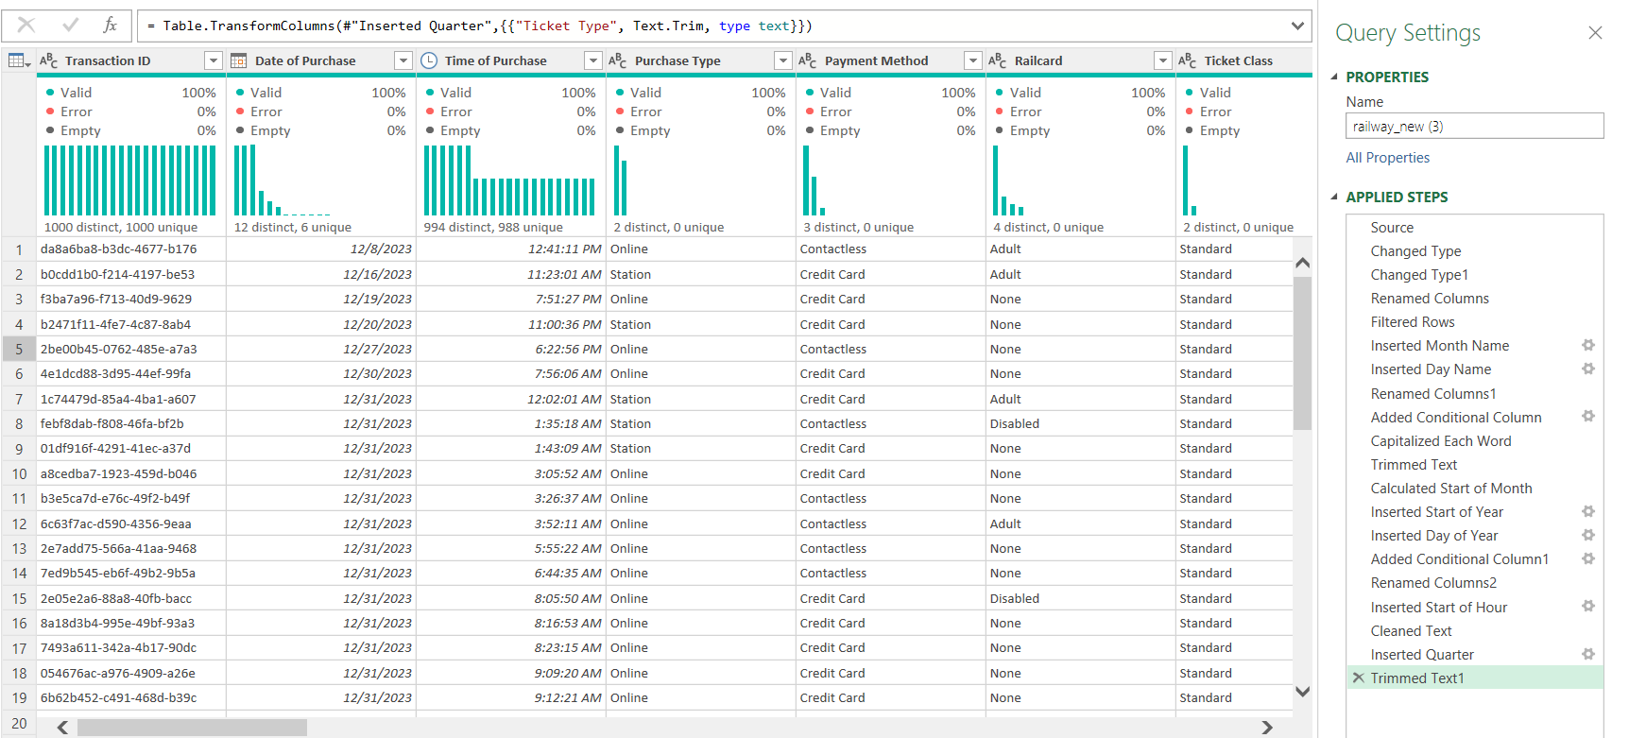

Before
06
After

Slide 7

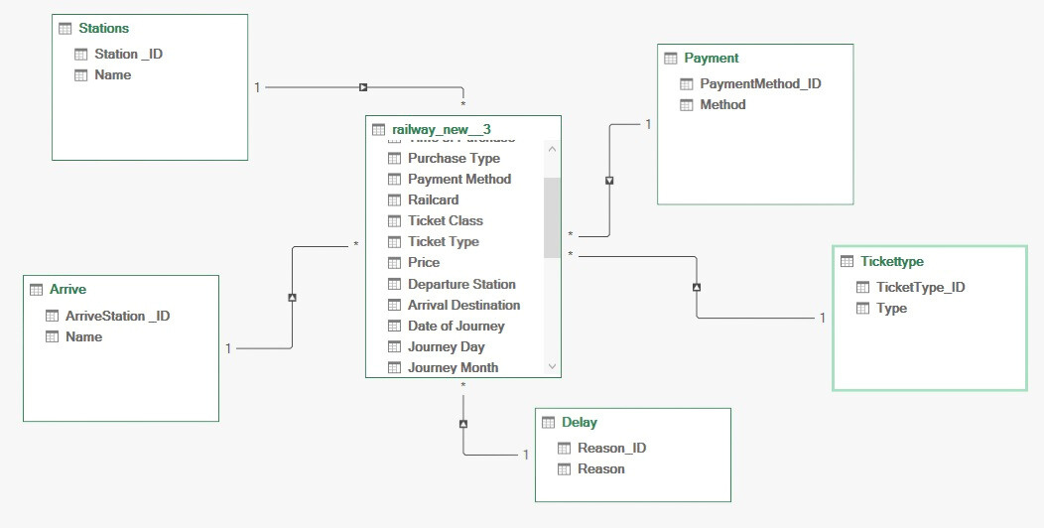
Data Modeling
07

Slide 8

08
DAX
Summary

Slide 9
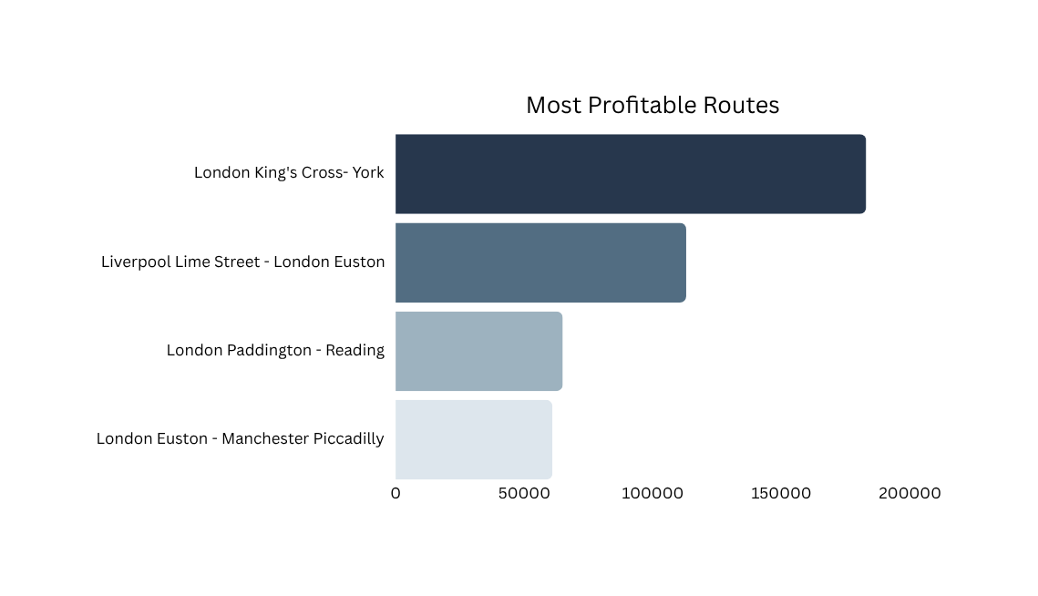
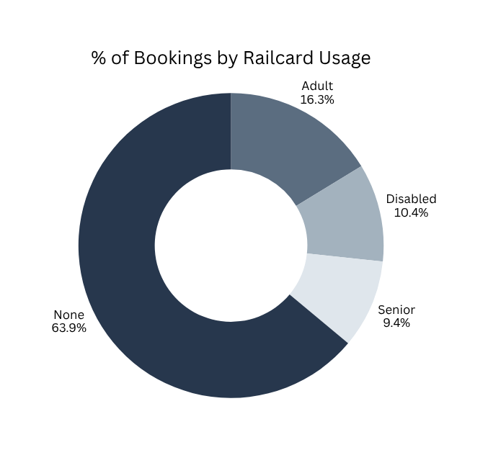
Visual Sample
09
Description:
This visual displays the top routes generating the highest total revenue across the network.
Insight:
You can quickly see which routes contribute most to overall profitability
Description:
This visual shows the percentage of bookings made with and without railcards.
Insight:
Most bookings are made without a railcard, while adult railcards account for the largest share among users who use one.

Slide 10
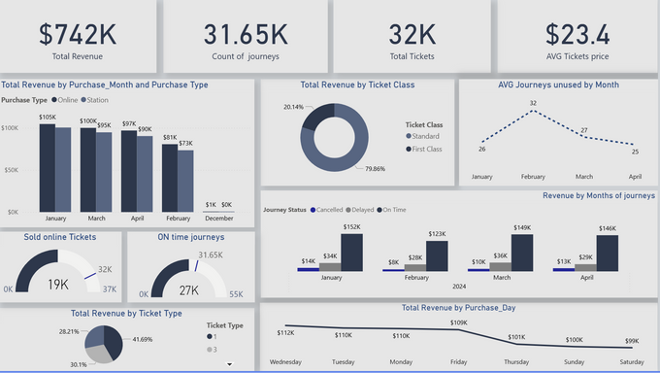


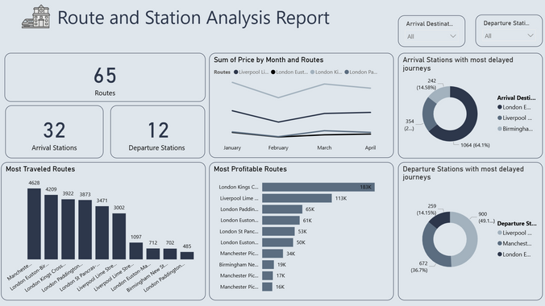





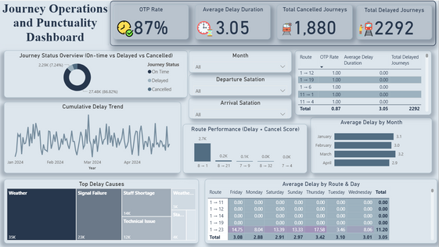
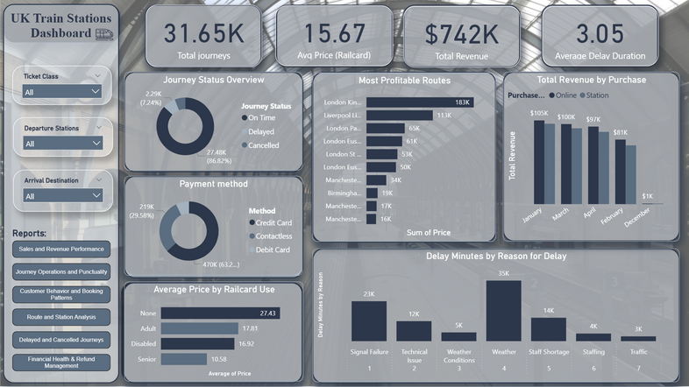
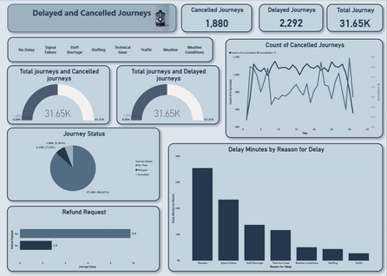




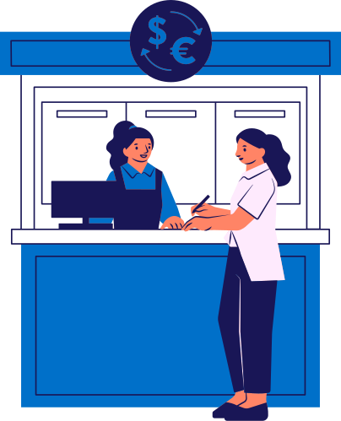

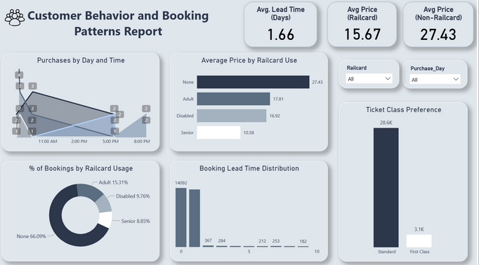
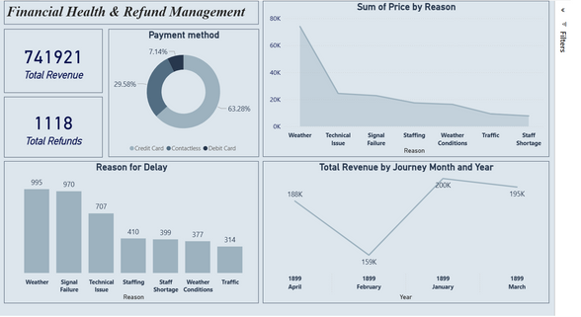
1
Sales and Revenue Performance
Route and Station Analysis
4
DASHBOARD
2
Journey Operations and Punctuality
Delay and Cancellation
5
3
Customer Behaviour and booking patterns
Financial Health and Refund Management
6

Slide 11






Sales Timing & Efficiency
Wednesday is the busiest sales day , yet February had the highest unused journeys (32.2).
11
Customer Tolerance & Risk
The refund request rate is extremely low (13% of eligible journeys), indicating high customer tolerance for minor disruptions.
Key
Findings
Low Railcard Use
Customers pay nearly double what they could, indicating missed opportunities for loyalty and guaranteed revenue.
Service Failures:
The London Euston station is the single biggest problem, causing over 64% of all arrival delays and nearly 50% of all departure
Infrastructure Focus
Standard Class dominates revenue 79.86% of total, and 62% of tickets are sold online.

Slide 12






Optimize capacity planning
12
Investigate why bookings convert poorly to travel in February, and use Wednesday sales data to forecast peak service demand.
Recommended
Actions
Proactive compensation
Implement an automated, small compensation system for minor delays to build trust and prevent a sudden drop in loyalty.
Drive loyalty
Aggressively promote railcards and advance bookings for predictable volume.
Strategic Action
Boost & Digitize
Fix Euston immediately to stabilize the 87% On-Time Performance.
Prioritize investment in Standard Class capacity and further digitization (mobile/app experience) over premium class expansion.

Slide 13

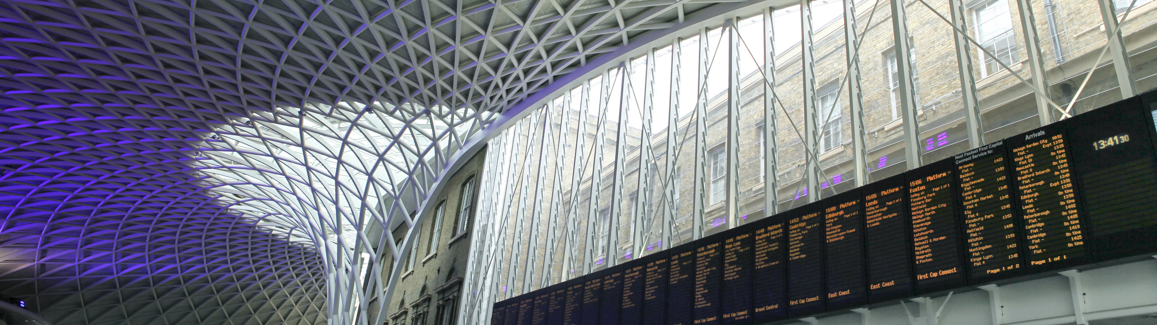

13
CONCLUSION
The analysis reveals that while the railway network is financially robust, its operational stability is compromised by a singular bottleneck, and its commercial longevity is dependent on unplanned, high-cost bookings. To secure long-term health, we must shift our focus from passively collecting high spot-fares to aggressively stabilizing our most critical hub and converting spontaneous travelers into committed, loyal customers.

Slide 14




THANK
YOU

